Slide 1

Machine Learning
Capstone Project
By
Sushant Jagtap
Team Member: Sushant Jagtap Akash Bhor

Slide 2
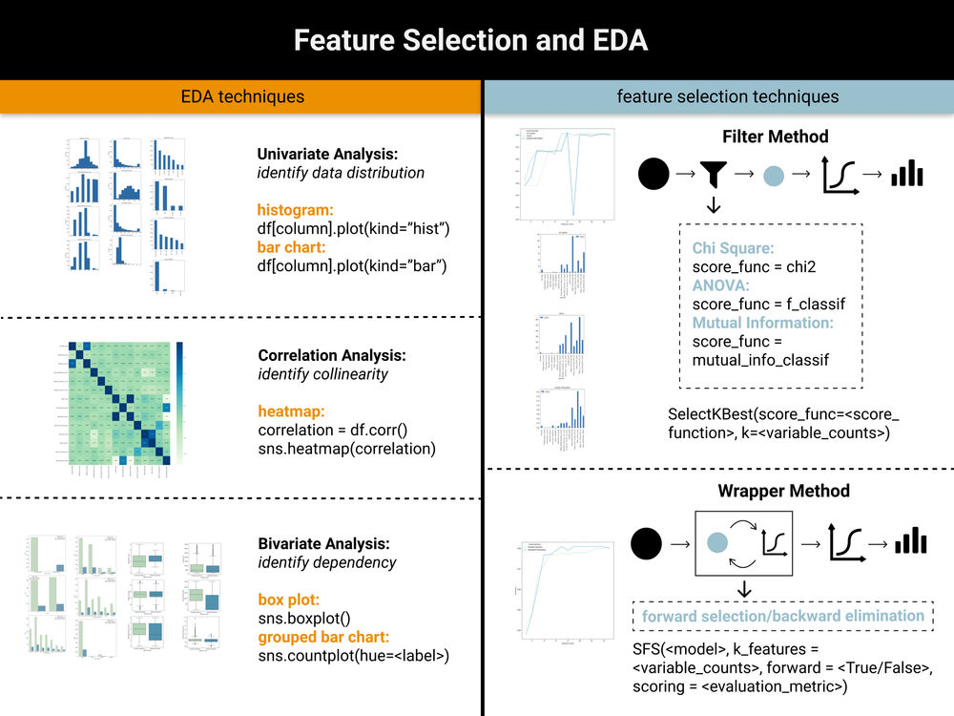
CONTENT
Defining problem statement
Data summary
Insights from our Dataset
EDA
Feature engineering
Applying ML algorithms
Comparing different ML models
Challenges
Conclusion

Slide 3
Defining Problem Statement
Rental bikes service is very crucial in many urban cities for the enhancement of mobility comfort. It is important to make the rental bike available and accessible to the public at the right time as it lessens the waiting time. Eventually, providing the city with a stable supply of rental bikes becomes a major concern. Therefore we have to predict the number of rental bikes required in each hour for smooth functioning of service.

Slide 4
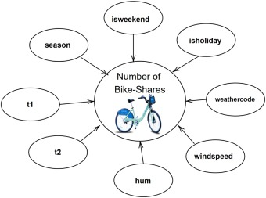
Data Summary We are given dataset containing count of rental bikes from December 2017 to November 2018 for each day and each hour of day. Along with count of rental bikes there are following variables also present. (1) Date : year-month-day (2) Rented Bike count - Count of bikes rented at each hour (3) Hour - Hour of the day (4) Temperature-Temperature in Celsius (5) Humidity - % (6) Wind speed - m/s (7) Visibility - 10m (8) Dew point temperature - Celsius (9) Solar radiation - MJ/m2 (10) Rainfall - mm (11) Snowfall - cm (12) Seasons - Winter, Spring, Summer, Autumn (13) Holiday - Holiday/No holiday (14) Functional Day - No (Non Functional Hours), Yes(Functional hours) ‘Rented Bike count’ is dependent variable.

Slide 5
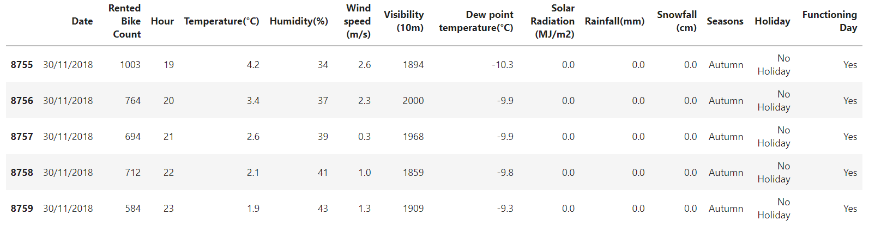
➢ This Dataset contains 8760 lines and 14 columns.
➢ Three categorical features ‘Seasons’, ‘Holiday’, & ‘Functioning Day’.
➢ One Datetime features ‘Date’.
➢ We have some numerical type variables such as temperature, humidity, wind, visibility, dew point temp, solar
radiation, rainfall, snowfall which tells the environment conditions at that particular hour of the day.

Slide 6
Data Summary
• Rented Bike Count
• Hour
• Temperature
• Humidity
• Wind speed
• Visibility
• Dew point temperature
• Solar radiation
• Rainfall
• Snowfall
• Date
• Seasons
• Holiday
• Functional Day
Categorical
Numerical
Dataset
Dependent variable is ‘Rented Bike Count’ that describes the count of rented bikes for each hour.

Slide 7
INSIGHTS FROM OUR DATASET
➢ There are No Missing Values present
➢ There are No Duplicate values present
➢ There are No null values.
➢ And finally we have 'rented bike count' variable which we need to predict for new observations
➢ The dataset shows hourly rental data for one year (1 December 2017 to 31 November(2018)(365 days).
we consider this as a single year data
➢ So we convert the "date" column into 3 different column i.e "year","month","day".
➢ We change the name of some features for our convenience , they are as below 'Rented_Bike_Count', 'Hour',
'Temperature', 'Humidity', 'Wind_speed', 'Visibility', ‘Dew_point_temperature', 'Solar_Radiation', 'Rainfall',
'Snowfall', 'Seasons', 'Holiday', 'Functioning_Day', 'month','weekdays_weekend'

Slide 8
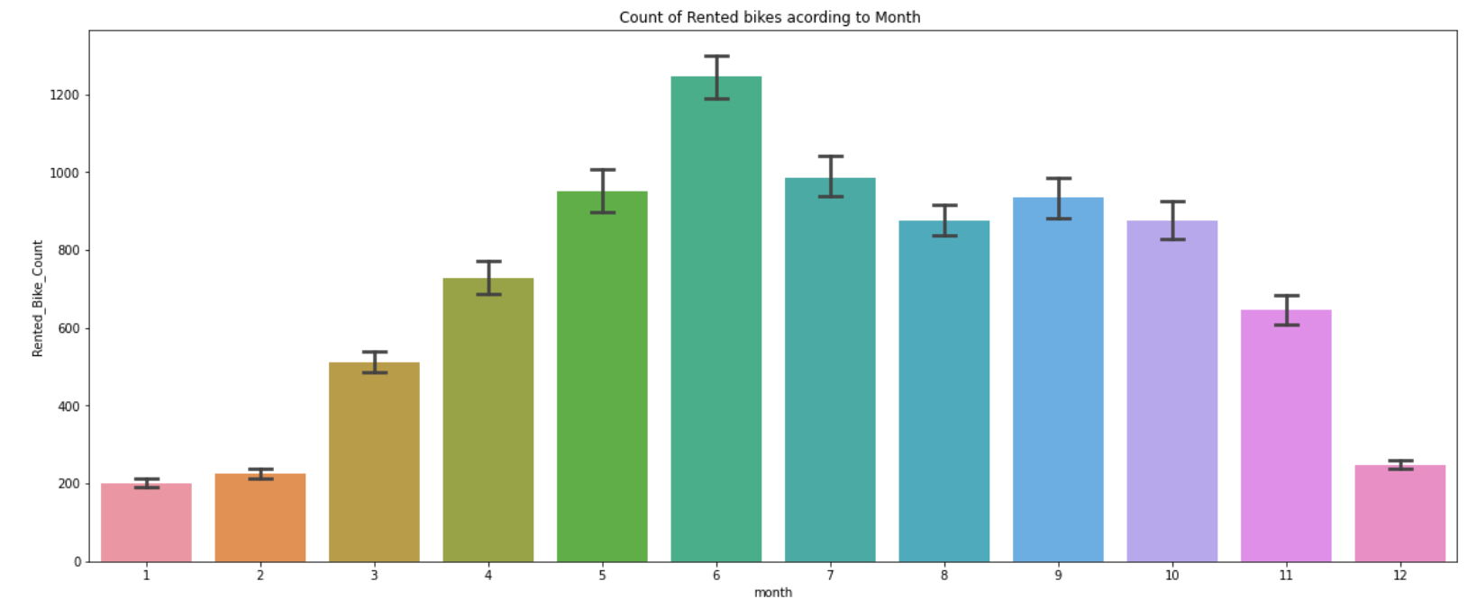
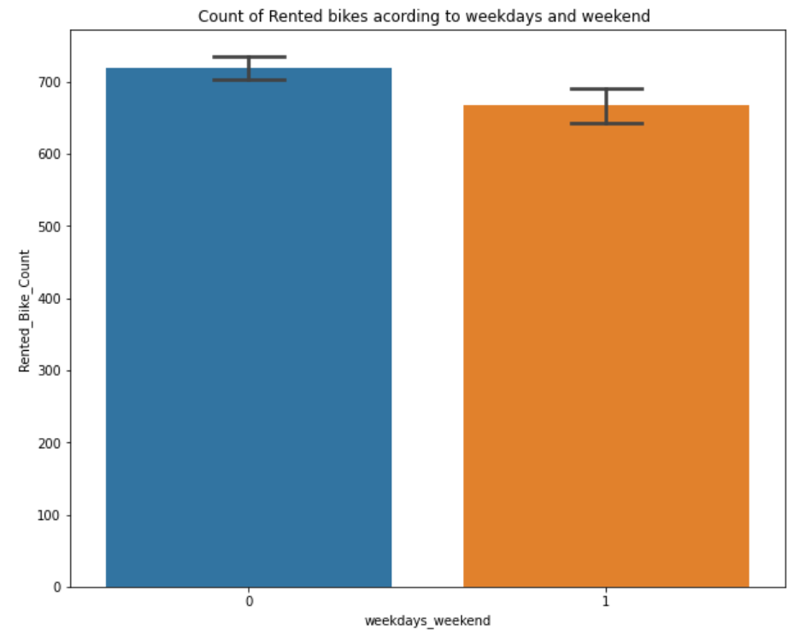
EDA Let us see how the values of ‘Rented Bike Count’ are distributed in given dataset. Distribution of values is highly positively skewed. ● From the above point plot and bar plot we can say that in the weekdays which represent in blue colour show that the demand of the bike higher because of the office. ● Peak Time are 7 am to 9 am and 5 pm to 7 pm ● The orange color represent the weekend days, and it show that the demand of rented bikes are very low especially in the morning hour but when the evening start from 4 pm to 8 pm the demand slightly increases. ● from the month 5 to 10 the demand of the rented bike is high as compare to other months. these months are comes inside the summer season.

Slide 9
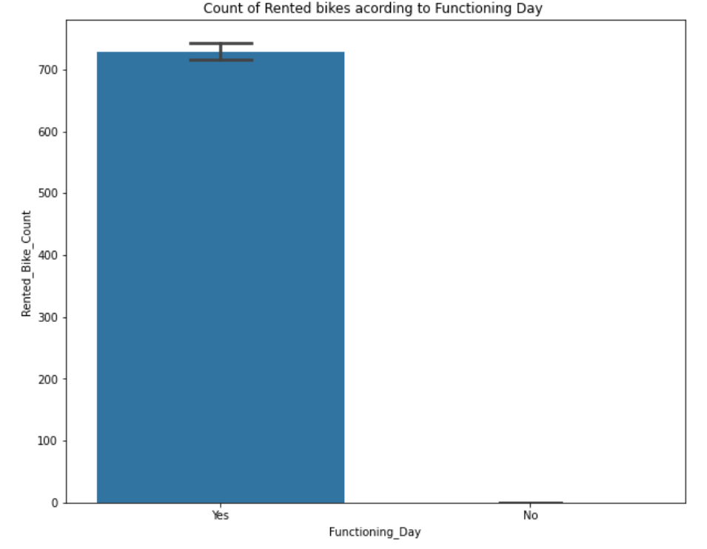
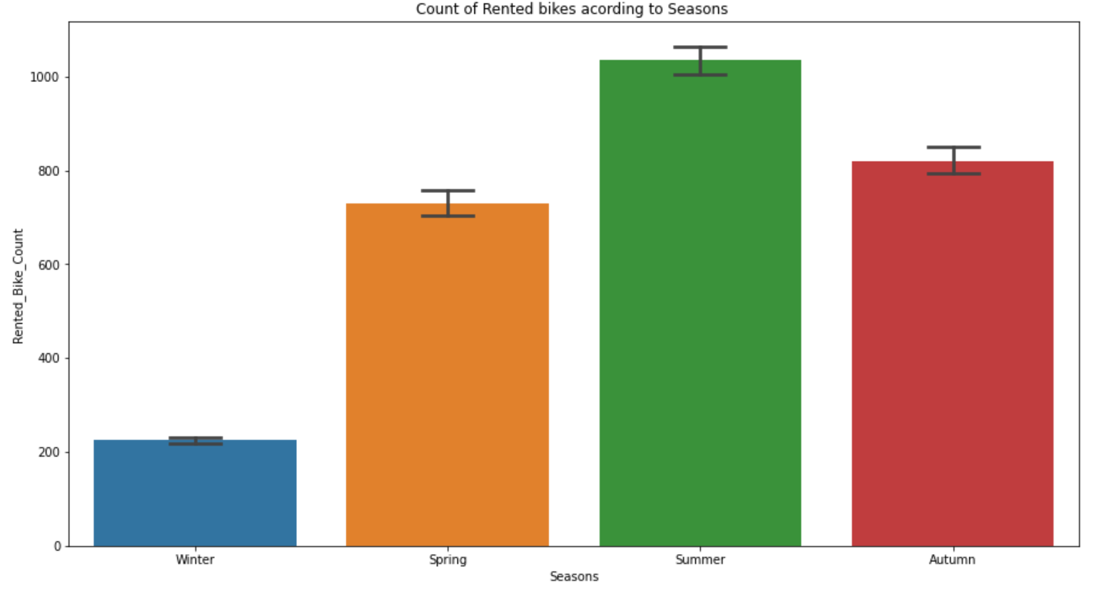
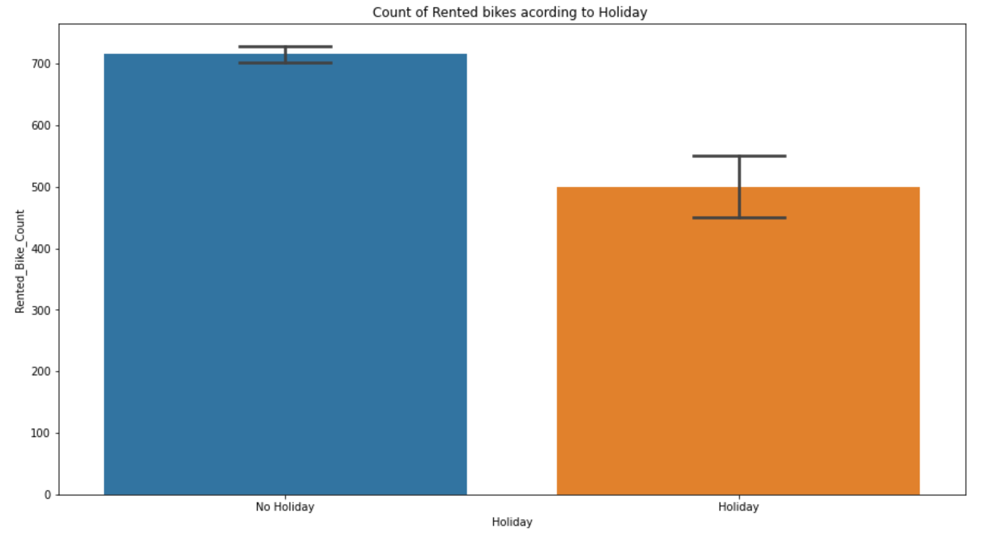
Count of values of categorical features. Functioning Day and Holiday have highly imbalanced count of values.

Slide 10
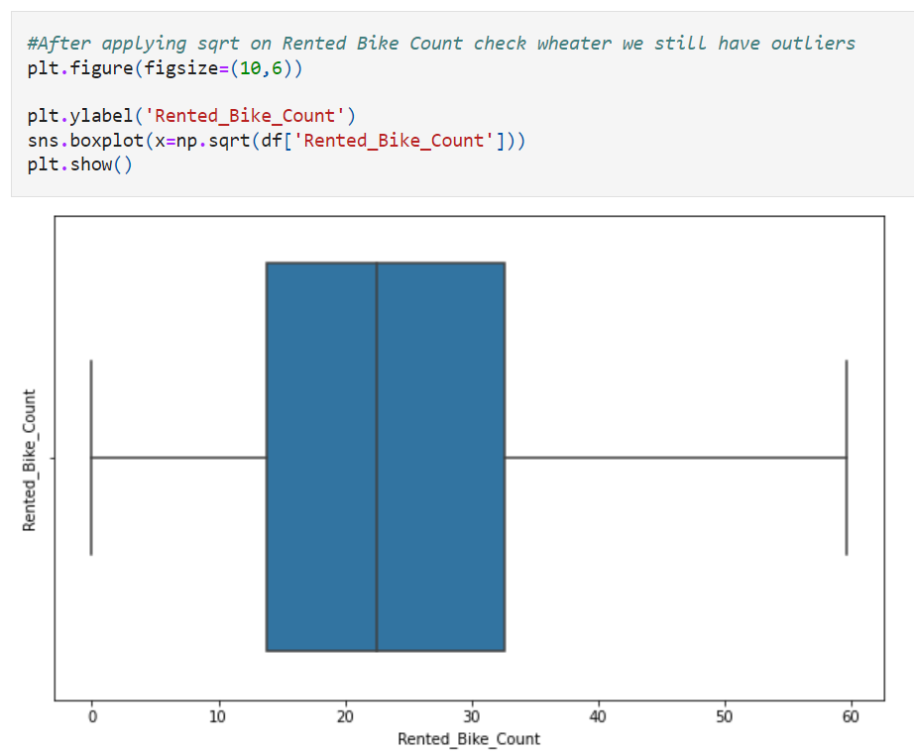
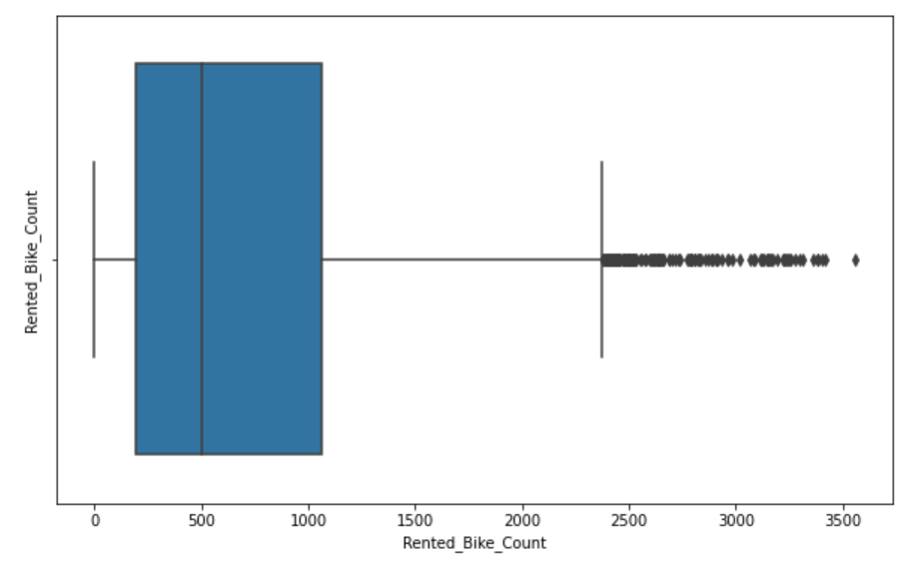
detect outliers in Rented Bike Count column ➢ The above graph shows that Rented Bike Count has moderate right skewness. ➢ The above boxplot shows that we have detect outliers in Rented Bike Count column ➢ Since the assumption of linear regression is that 'the distribution of dependent variable has to be normal', so we should perform Square root operation to make it normal ➢ After applying Square root to the skewed Rented Bike Count, here we get almost normal distribution. ➢ After applying Square root to the Rented Bike Count column, we find that there is no outliers present

Slide 11
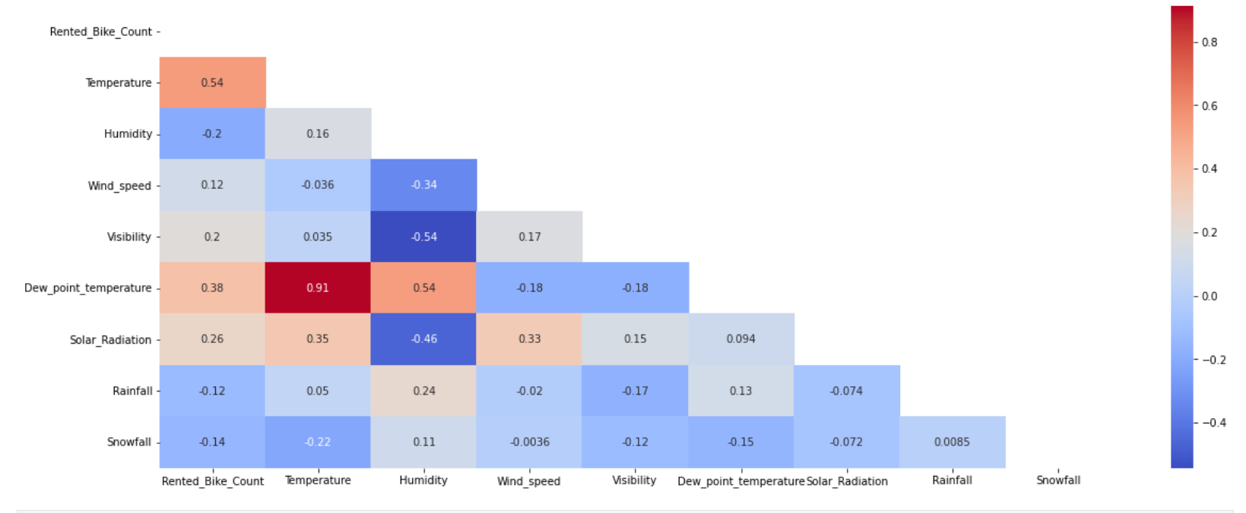
the most positively correlated variables to the rent are : And most negatively correlated variables are: the temperature Humidity the dew point temperature Rainfall the solar radiation

Slide 12
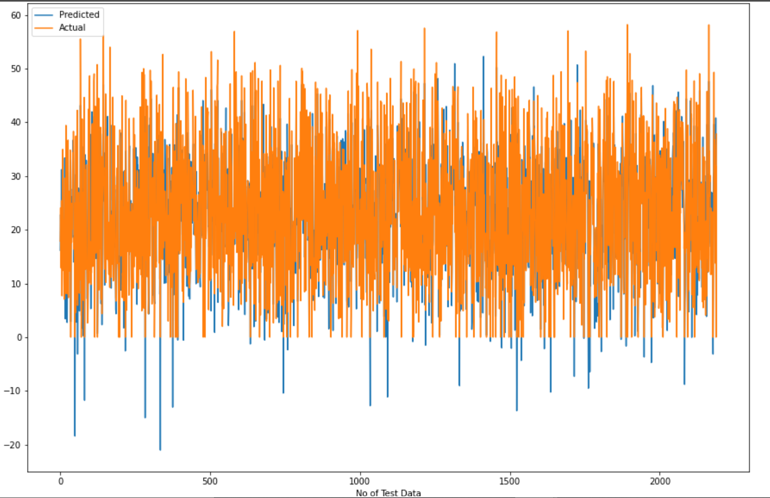
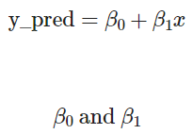
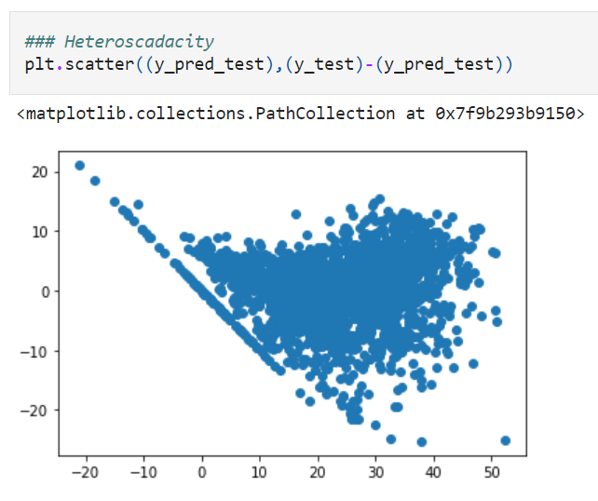
Linear Regression Looks like our r2 score value is 0.77 that means our model is able to capture most of the data variance. The r2_score for the test set is 0.78. This means our linear model is performing well on the data.

Slide 13
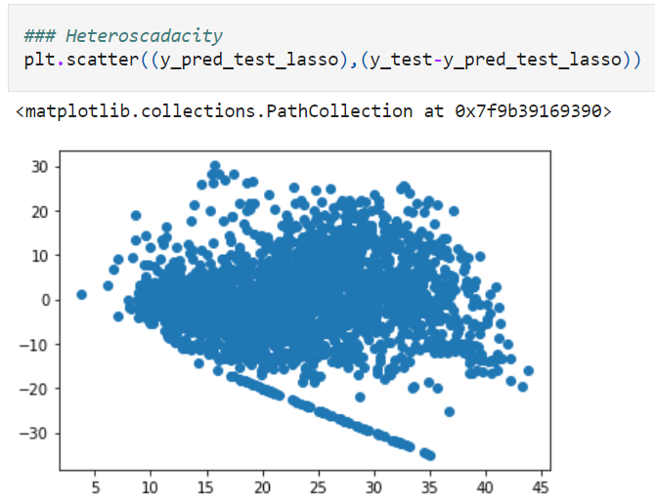
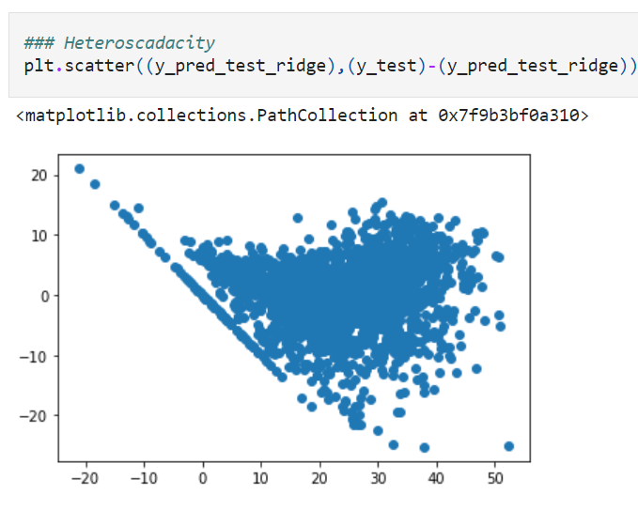
LASSO REGRESSION RIDGE REGRESSION Looks like our r2 score value is 0.40 that means our model is not able to capture most of the data variance. The r2_score for the test set is 0.38. This means our linear model is not performing well on the data. Looks like our r2 score value is 0.77 that means our model is able to capture most of the data variance. The r2_score for the test set is 0.78. This means our linear model is performing well on the data.

Slide 14
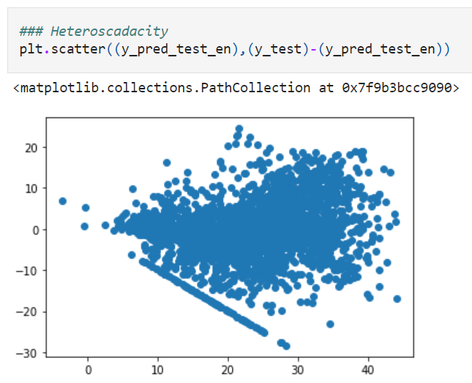
ELASTIC NET REGRESSION Looks like our r2 score value is 0.62 that means our model is able to capture most of the data variance. The r2_score for the test set is 0.86. This means our linear model is performing well on the data.

Slide 15
Features transformation Due to presence of categorical features we cant feed data directly in ML algorithm. We need to transform categorical features that have strings datatype to numerical datatype. For which we have used One-hot encoding and label encoding for categorical features. One Hot Encoding Similarly for ‘Holiday’ and ‘Functional Day’ feature.
Seasons
Summer
Winter
Autumn
Spring
Summer | Winter | Autumn | Spring
1 | 0 | 0 | 0
0 | 1 | 0 | 0
0 | 0 | 1 | 0
0 | 0 | 0 | 1

Slide 16
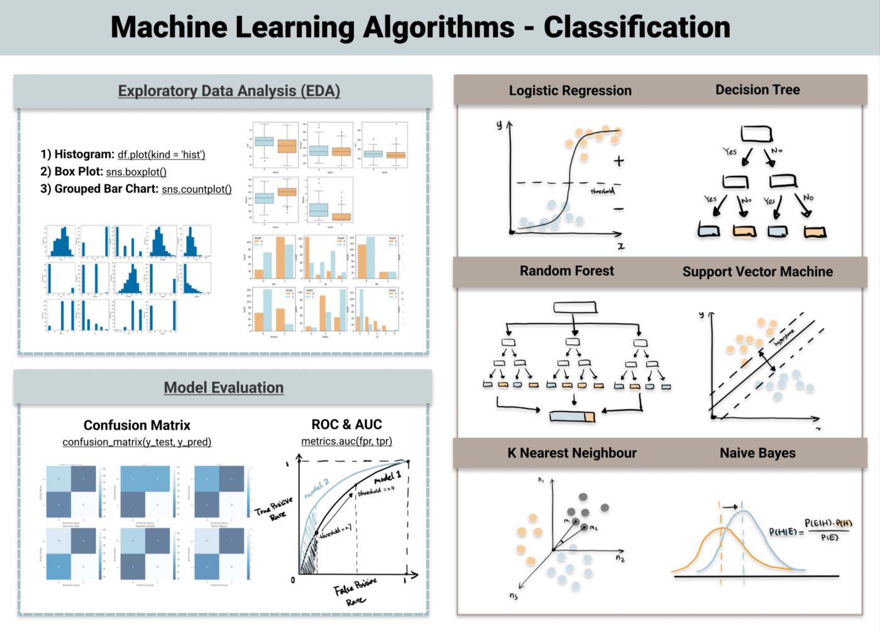
Applying ML Algorithms Since we have to predict the count of rented bikes required per hour. Hence, we have to use regression algorithms. Algorithms that we will use are: • Decision Tree • Random Forest • Linear Regression • Lasso Regression • Ridge Regression • Elastic Net Regression

Slide 17
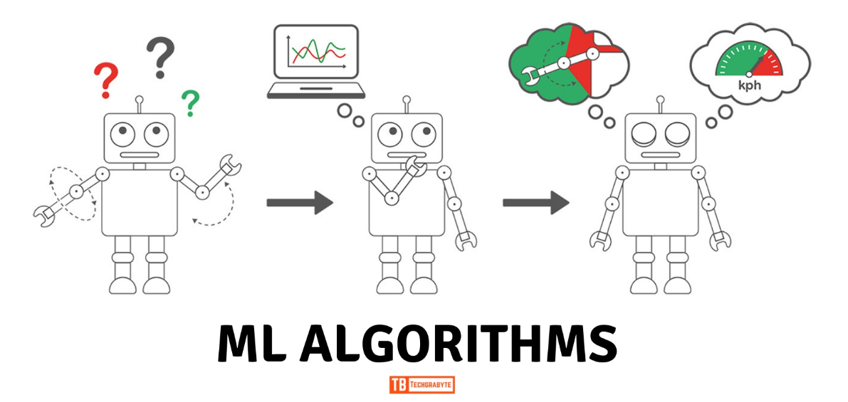
Applying ML Algorithms Applying supervised ML algorithms have following steps
Preparing data for model
Training and Hyper parameter tuning
Evaluating model on test data

Slide 18
CHALLENGES
➢ Large Dataset to handle.
➢ Needs to plot lot of Graphs to analyse.
➢ Feature engineering
➢ Feature selection
➢ Optimising the model
➢ Carefully tuned Hyperparameters as it affects the R2 score.

Slide 19
Conclusion In the given dataset there was no strong linear relation between dependent variable ‘Rented Bike Count’ and independent features. That’s why Linear regression model and its other regularization variant models didn’t performed well. Out of all models we apply Decision tree and Random forest model are most accurate. Reason for this are no specific relation between features and large data. Random Forest performed best as it is an ensemble model and result from multiple decision trees is average out to give the prediction.

Slide 20
1. Functioning day is the most influencing feature and temperature is at the second place for LinearRegressor. 2. Temperature is the most important feature for DecisionTree, RandomForest and GradientBoosting Regressor. 3. Functioning day is the most important feature and Winter is the second most for XGBoostRegressor. 4. RMSE Comparisons: (a) LinearRegressor RMSE : 370.46 (b) DecissionTreeRegressor RMSE : 302.53 (c) RandomForestRegressor RMSE : 290.02 (d) XGBoostRegressor RMSE : 242.72 (e) GradientBoostingRegressor RMSE : 248.18 5. The feature temperature is on the top list for all the regressors except XGBoost. 6. XGBoost is acting different from all the regressors as it is considering whether it is winter or not. And is it a working day or not. Though winter is also a function of temperature only but it seems this trick of XGBoost is giving better results. 7. XGBoostRegressor has the Least Root Mean Squared Error. So It can be considered as the best model for given problem.

Slide 21
THANK YOU !...

